Slide 1

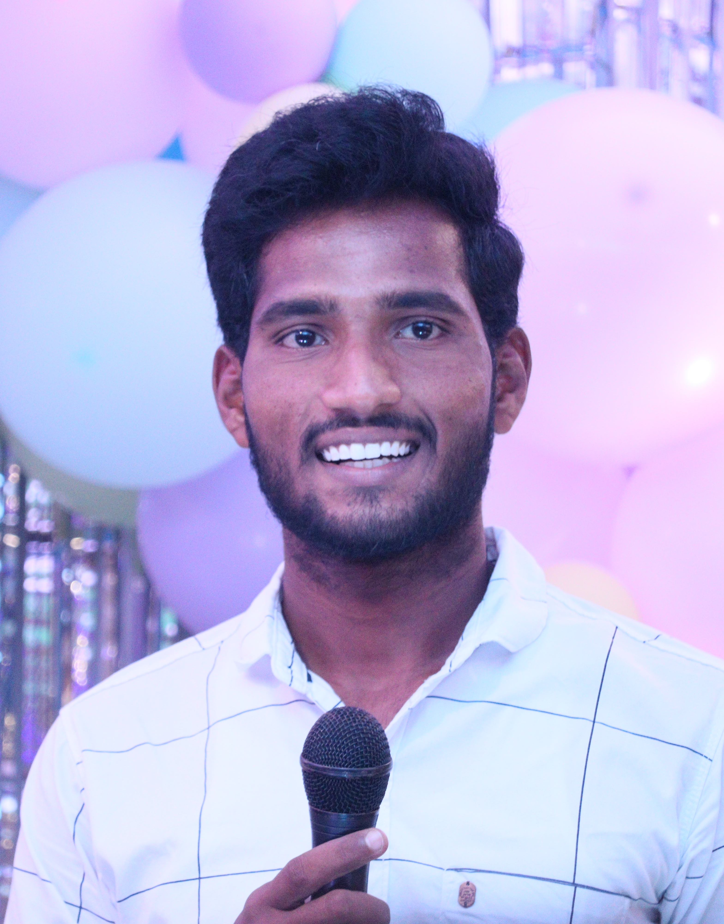

self intro of Bhargav
I'm Bhargav ,I am currently residing in my home polireddy palem, ongole , Andhra Pradesh.​
I'm interesting to play chess and cricket, enthusiastic about learning new technologies as well.
I love to write coding and watching web series .​
I'm a "Blood Donar".​
I'm a certified NCC candidate in my school.
I believe a quote " you can always find a solution if you try hard enough ".​
My Objective is to become an "Ethical Hacker".​

Slide 2
Summary abut communication skills
verbal communication : To convey a message in a good manner ( written or oral communication).
non-verbal communication: make an eye contact, facial expressions and should be maintain proper dress code , hand gestures.
presentation : Be prepared when you give presentation and make use poper language to convey a message.
active listening is required.
solution oriented ( when you have a problem then ask somebody to solve it ).
be attentive when others explaining related to work.
believe or trust is important between the colleague and clients , if a team member has absent then take care of his/her work .
cultural awareness is important ( when we communicate with foreign clients).
patience is more important in communication what others talk about and listen patiencly until unless they complete.

